Slide 1
USED CAR MARKET
Team: Ahjeong Yeom, Akhir Syabani, Jessica Addai, Kenji Laurens, Ruofan Yao, Zongyuan Yu

Slide 2
CONTENTS
01
Executive Summary
Background
Business Problems
02
Data Collection
03
Explanatory Data Analysis
Statistical Summary
Clustering Summary
Topic Modeling
04
Data Preprocessing & Feature Engineering
Pre-Modeling
Re-engineering
05
Modeling & Evaluation
Result Comparison
Evaluation Criteria
06
Insights & Recommendations
Key findings & Challenges
Recommendations

Slide 3
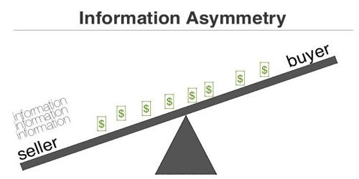
Executive Summary
Background
Asymmetric information, also known as “information failure,” takes place during a transaction where one party has greater material knowledge or better information than the other party.
“The Market of Lemons: Quality Uncertainty and the Market Mechanism,” by George Akerlof
Our Solution
Help consumers stay informed on what features determine car price
Help consumers and sellers have baseline for reasonable price points for cars
Better information leads to better decisions on major purchases like cars
Business Problem
Consumers face incomplete information on used cars
Eventual Market Failure
Notes:
Help consumers stay informed on what determines car price.
Help consumers and sellers have baseline for reasonable price points for cars.
Better information leads to better decisions on major purchcases like cars.

Slide 4
Used Car Price Analysis
Statistical Summary
Distribution
Correlation
Craigslist
Used Car Data
Understanding the Data
Clustering
Cluster Characteristics
Kaggle
Final
Dataset
Text Mining
Topic Modeling (Top2Vec)
Findings
Insights
Recommendations
Difflib Matching
Results
MSRP Price
Problem
Questions
Modeling: Regression
Linear Regression
Linear SVR
Decision Tree
Random Forest
Gradient Boosting
XGBoost
Kaggle
Web Scraping
Offering Price Factors
Price Depreciation
Market Segments

Slide 5



Data Collection Collection
Our dataset is taken from Kaggle public dataset (1.45 GB)
Based on resale car listings on Craigslist
Columns include selling price, car attributes, color, condition, VIN, mileage, make and model, etc.
Enhanced and imputed some data with data from iSeeCars
Problems arose with dirty and bad data
Since each listing data is 100% based on seller entry, sellers tend to input false data, intentionally or otherwise

Slide 6
Data Collection Incorporating External Data
To impute some of the columns, we looked at the most common value for each car model
Assumptions:
Cars of the same make and model share common attributes such as cylinders, type and size
For customizable attributes (drive type) we are assuming the most common values for each model
We collected data from iSeeCars through web scraping
Data scraped include MSRP and car attributes for all makes and models available
Problem:
Due to user-input values, car model names may not match exactly with the clean names from iSeeCars
To overcome this problem, we used OpenRefine to try and fix some of the entries based on naming clusters
We also used SequenceMatcher from the difflib library to programmatically fix model names based on similarity index and assigned model with the highest name similarity
Toyota Corolla
Corola
Crollao
Colorra
Corollla

Slide 7
Data Collection Available Columns
Data Types
Irrelevant
Relevant
High Cardinality:
ID
URL
Image_URL
VIN
Categorical:
Region
Region_URL
Categorical:
Manufacturer
Model
Condition
Cylinders
Fuel
Title Status
Transmission
Drive
Type
Paint Color
State
Continuous:
Price
MSRP
Odometer
Time:
Year
Posting Date
Geolocation:
Longitude
Latitude
Null:
County (100%)
Size (>70%)
Text:
Description
Notes:
First we look at the data types and relevance of each variable.
We can see that most of our relevant variables are categorical.
Our predicted variable, Price is a continuous variable that we will try to predict using regression.
For manufacturer, model, and posting date (italicized) are not going to be used as relevant variables but we use them to generate additional variables:
To match with external data (MSRP)
To calculate the car age (production year against the posting date)

Slide 8
Data Collection Feature Selection and Imputation
Dropped columns:
Imputed Columns:
ID | VIN | URL | Latitude | Longitude | Image URL
Region | Region URL | County | Size | Description
Method | Column / Features
Mode | Title Status Fuel Color
Based on other columns | Condition
Based on external dataset | Manufacturer Model Drive Cylinder Type
Notes:
Condition: other columns
Cylinders: model external dataset (+ mode)
Fuel: mode (with model)
Title Status: mode
Drive: model external dataset (+ mode)
Type: model external dataset (+ mode)
Color: mode
Odometer: normalized
Transmission: drop nulls

Slide 9
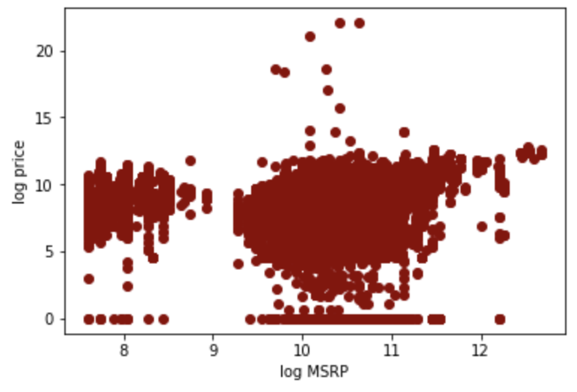
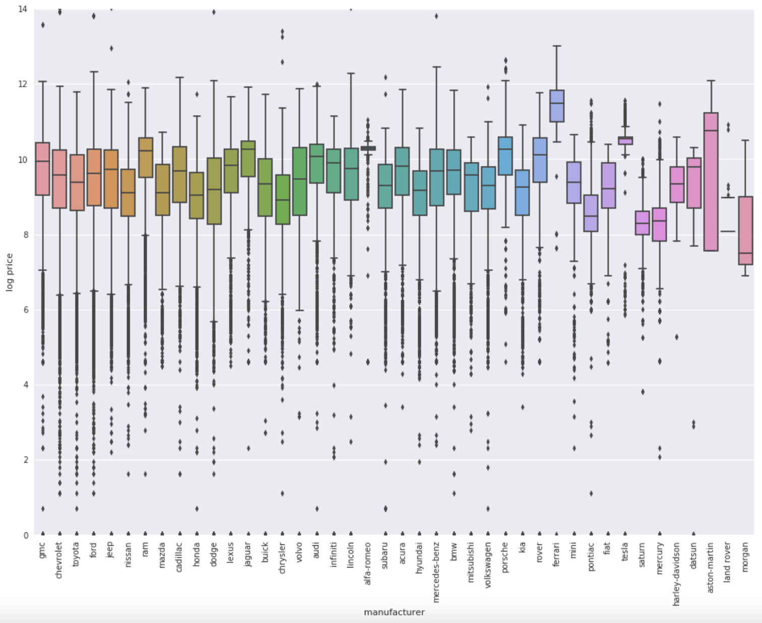
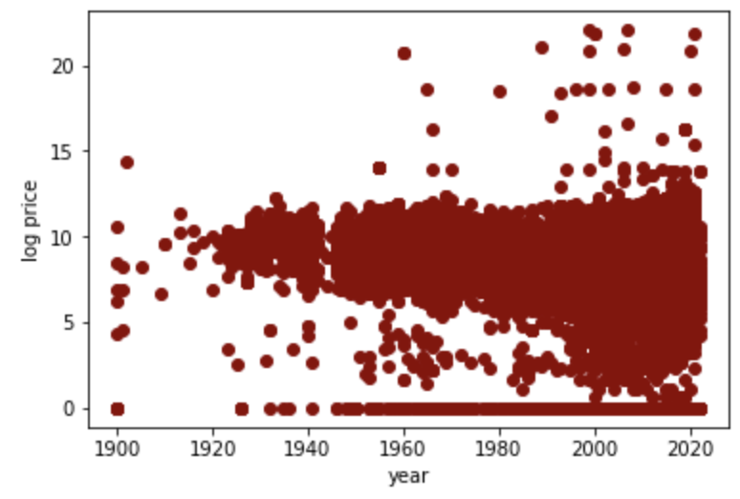
Exploratory Data Analysis (EDA) Raw & Filtered Data
Price by MSRP
Price by Manufacturer
Price Production Year
Notes:
Price against several key variables:
There seems to be a significant difference of price ranges between car manufacturers. However the range within each manufacturer seems very large. It is most possibly due to high number of different car models. That's why we will not include manufacturer and model as predictors as they can be better represented by other more relevant variables.
For MSRP and Production, at a glance, there doesn’t seem to be a clear linear relationship to price. But when we look closely, there's an indication of higher price with a higher MSRP and the latest the production year is.

Slide 10
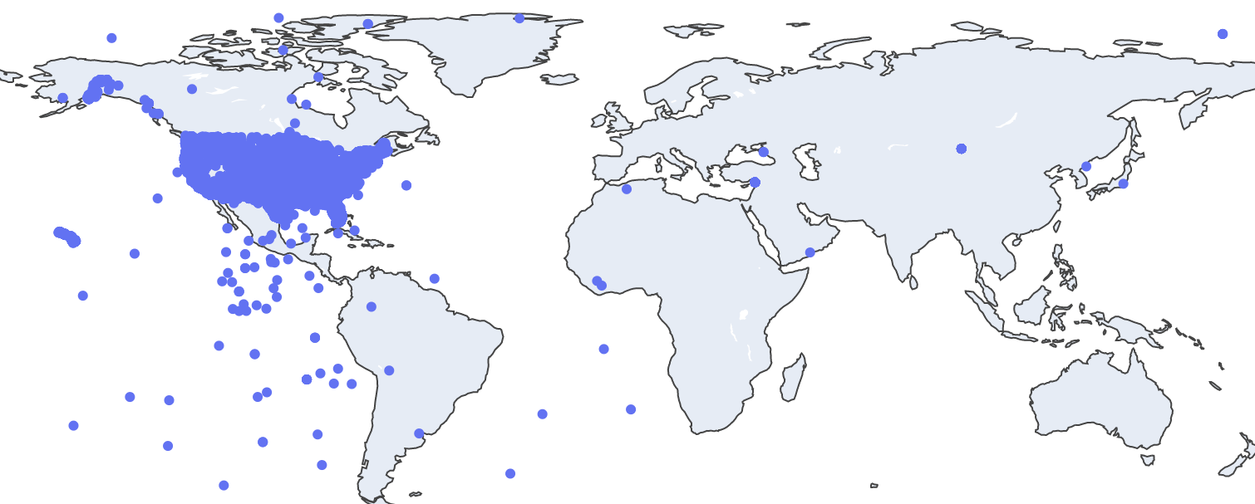
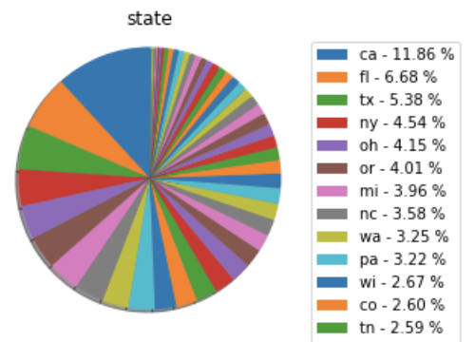
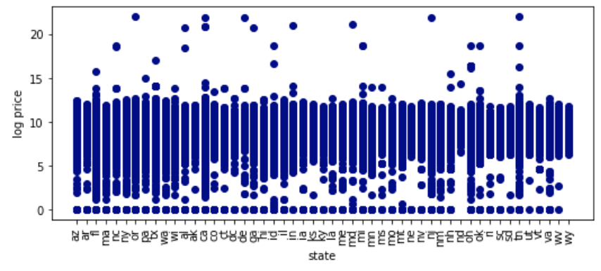
Exploratory Data Analysis (EDA) Raw Data by Region
Geo Location: Longitude, Latitude
Distribution
Price by State
Notes:
Next we're looking at regional distribution of the listings. From the longitude and latitude we can see that the listings are focused in the US, with some anomalies outside the US. We were not doing any transformation to this as we will not use this as predictors.
By state, the data is distributed quite evenly. We can also sense that there is a pattern that certain states have narrower range than other states. So based on this, state may be a good predictor for the price.

Slide 11
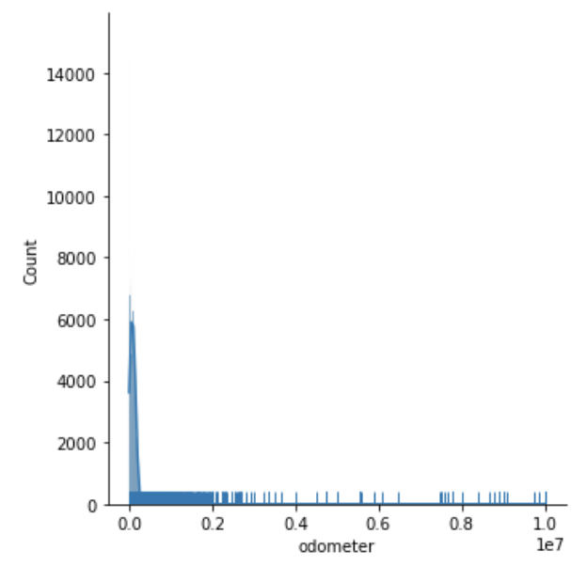
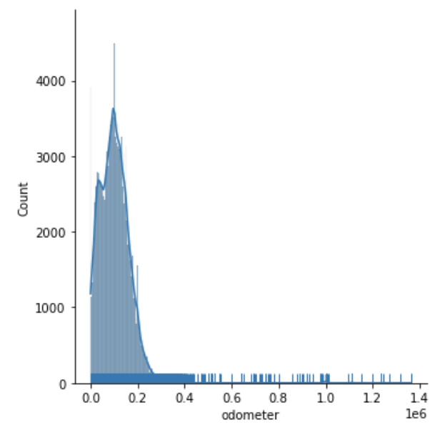
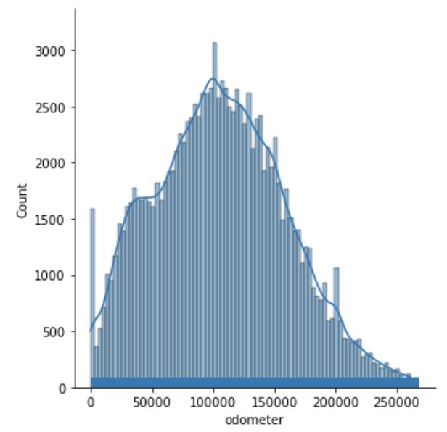
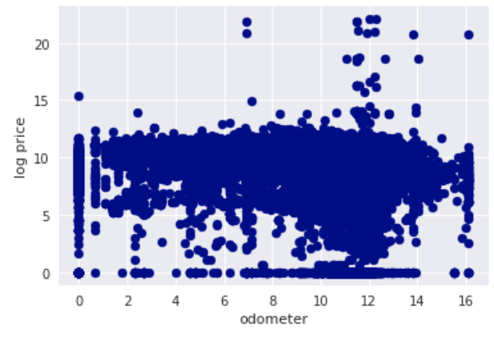
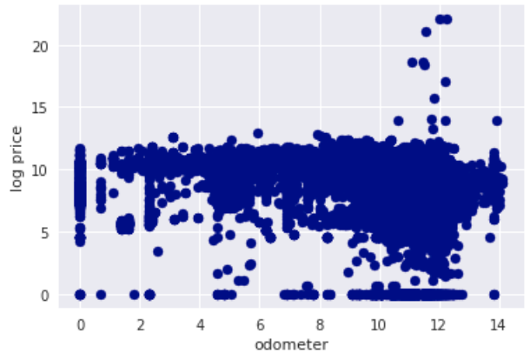
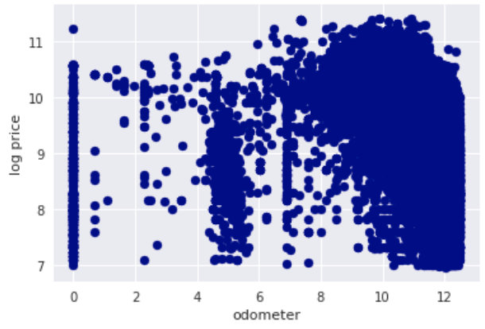
Exploratory Data Analysis (EDA) Highlight: Odometer
Raw Data
Filtered Data (by MSRP)
Clean/Final Dataset
Distribution
Against Log Price
Notes:
We would like to give special highlight to odometer. As you can see, the raw data is highly right-skewed, indicating there are high anomalies and outliers.
We tried to normalize the data by creating decision threshold based on the distribution and literary findings (would be explained in more details during feature engineering part). And we can see that there is a clearer relationship to price after we did the cleanup.

Slide 12
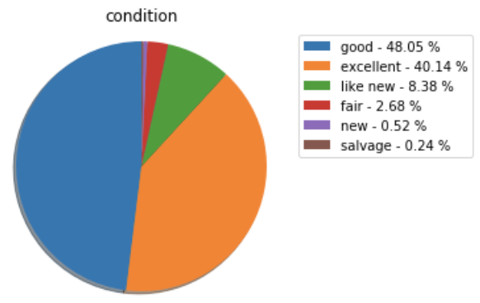
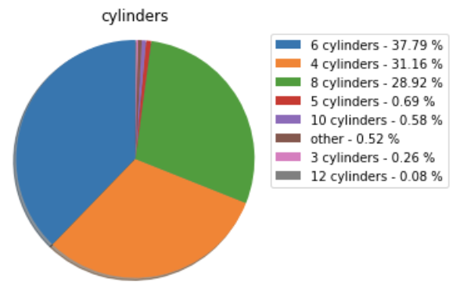
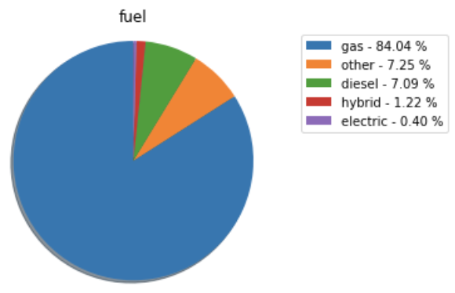
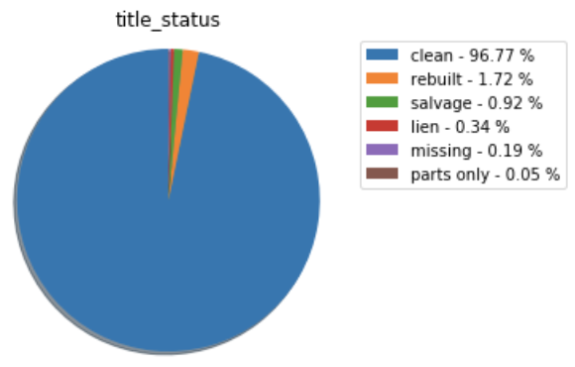
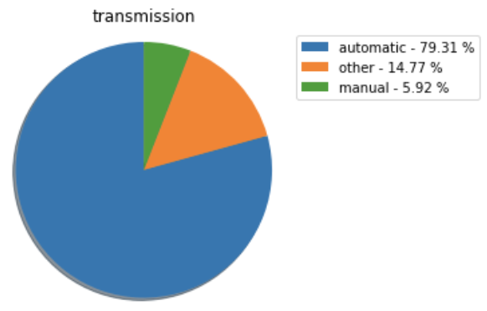
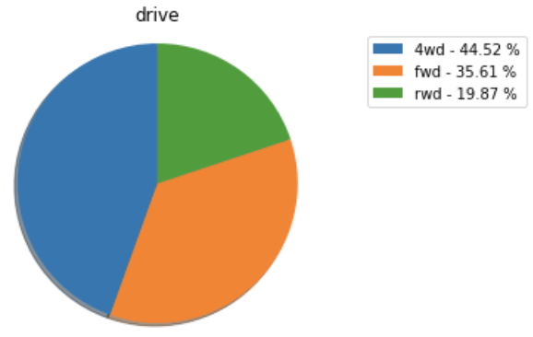
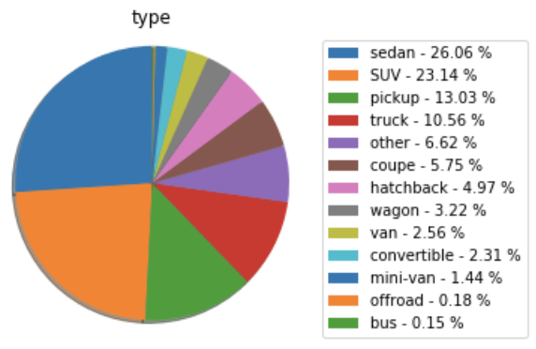
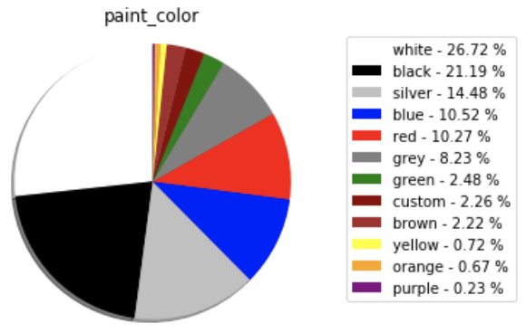
Exploratory Data Analysis (EDA) Raw Data: Other Categorical Variables
Notes:
For other variables, we were looking at the distribution of each categories.
There seems to be a clear dominance of certain categories in certain variables.
We used this as one of the imputation methods where we would pick the mode to fill up the nulls, when there is no better approach.
Other possible method is to reduce the possible skewness and clearer distinction by imposing decision threshold to make the categories binary, such as for paint color.
We use all of these variables to test out the model.

Slide 13
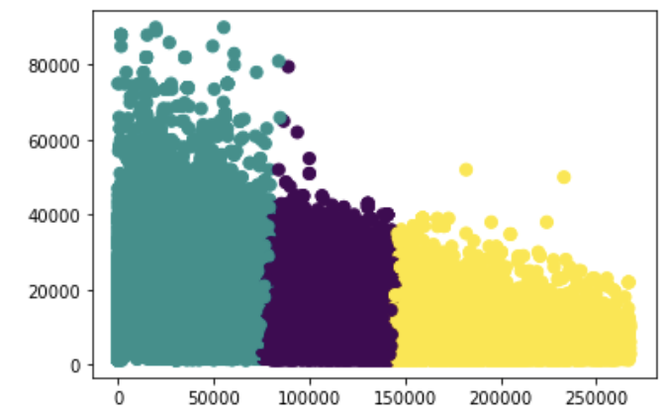
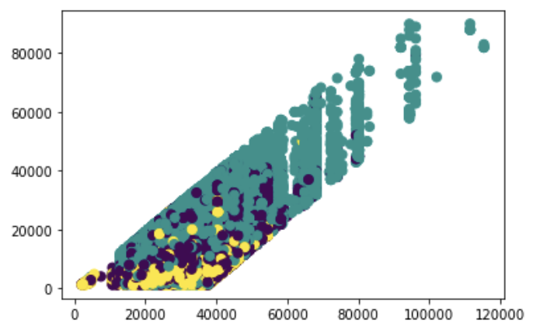
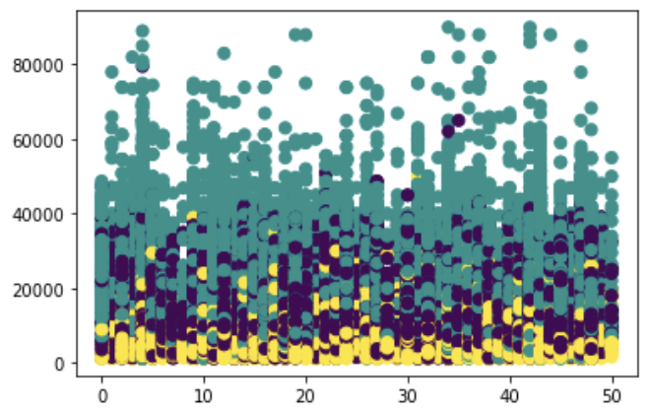
Exploratory Data Analysis (EDA) Clustering Summary (Clean Dataset, K-Means, 3 Clusters)
X = Odometer, y = Price
X = MSRP, y = Price
X = State, y = Price
Key Characteristics
Cluster | Price | Odometer | MSRP | Car Age | Vintage | Color
Cluster0 "Lower" | Min: 1k Max: 52k Mean: 7k | Min: 143k Max: 268k Mean: 177k | Max: 65k Mean: 30k | Mean: 14 | 0.04% | 46% neutral
Cluster1 "Mid" | Min: 1k Max: 80k Mean: 12k | Min: 75k Max: 125k Mean: 110k | Max: 96k Mean: 31k | Mean: 10 | 0.30% | 51% neutral
Cluster2 "Upper" | Min: 1k Max: 90k Mean: 21k | Min: 0 Max: 85k Mean: 45k | Max: 102k Mean: 33k | Mean: 6 | 0.82% | 53% neutral
Notes:
We also tried to perform clustering to understand the data better in terms of the market segment as one of our problem question.
We experimented with multiple clustering methods, and we decided to choose K-Means with 3 clusters that makes the most sense to interpret.
We visualized all of the independent variables against price, and these three variables seem to have the clearest distinction and indicate that they might good predictors.
We have 3 clusters:
Cluster 0, as the "Lower Class Segment"
Cluster 1, as the "Middle Class Segment"
Cluster 2, as the "Upper Class Segment"
We can see that Price and MSRP will consistently increase following the higher the class is, while Odometer and Car Age will decrease as the class gets higher. Interestingly, the proportion of vintage and neutral cars increase in higher segments.

Slide 14
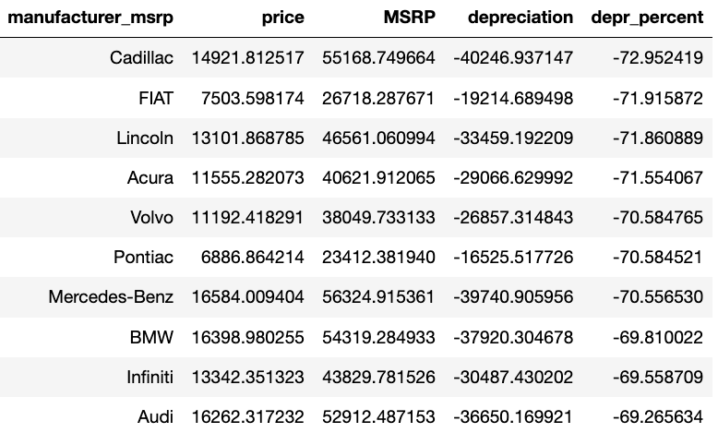
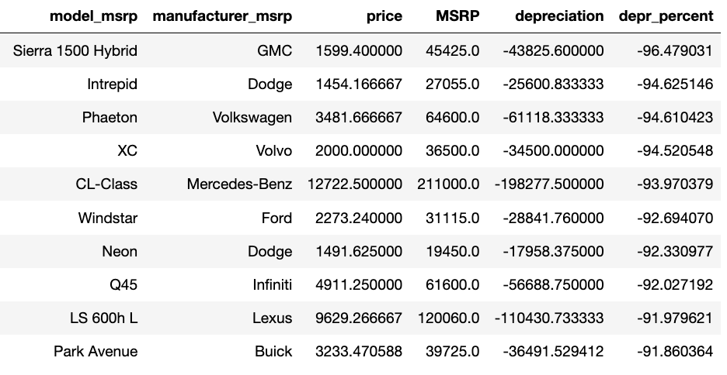
Exploratory Data Analysis (EDA) Price Depreciation
Avg MSRP | $ 31,328
Avg Price | $ 13,670
Depreciation | $ -17,658
Depreciation % | -56%
Exemplifies the commonly held notion that Asian car values depreciate less
Notes:
We also take a look at the average depreciation of used car in general.
We found out that the price will increase about 56% in average from its original price, which can go as low as 72% based on the manufacturer, and 96% based on the car model. From this list we can also see that not many Asian cars are in the top 10 most depreciated, exemplifying the commonly held notion that Asian car values depreciate less in general.

Slide 15
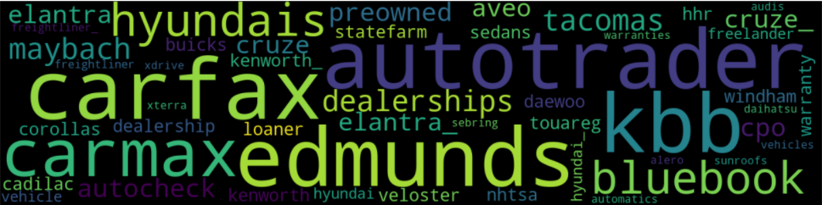
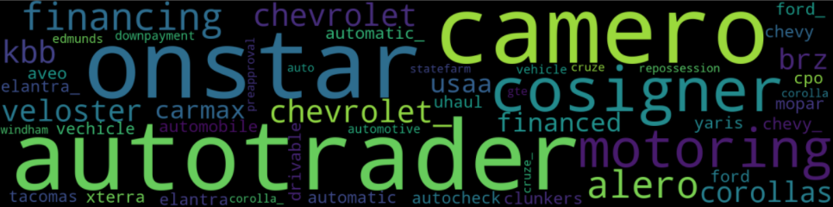
Exploratory Data Analysis (EDA) Topic Modeling With Top2Vec
For the "Description" column of our data, we use Top2Vec algorithm to see whether we can extract useful information
Top2Vec -- An algorithm that can perform topic modeling on text. It returns the number of the topics it finds from the text, and the keywords from each topic. It can also generate word cloud to help us visualize the keywords in certain topic.
From our result, we get more than 1000 topics back, and the keywords in each topic are not similar with each other. Thus, the “Description” column is not informational and should not be included in our model
However, one insight we have is that a lot of used car company advertise their car on craigslist since a lot of the keywords revolve the names of some used car companies, like Carfax, Carmax, Autotrader, etc.
Fig 1. Two examples of the generated keyword clouds

Slide 16
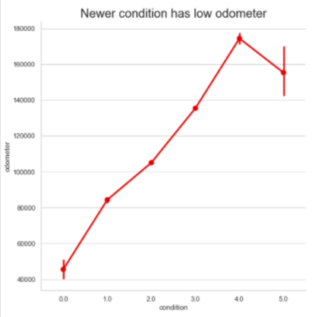
Data Preprocessing & Feature Engineering Pre-Modeling Continued – Imputation Continued
Initial Outlier handling & filling in null values
Odometer:
Highly right skewed
Outliers are removed: Upper threshold +7* stdev
Condition: fill nulls based on odometer
Quantile <25% = Excellent
Quantile 25%-50% = Good
Quantile >50% = Fair
NA = Fair
Transmission:
Automatic, manual, other -> not possible to assume car transmission type based on other features
drop NA rows (~0.6%)
Categorical variables: we filled in NA with mode
For cylinders, drive, type, fuel
Fill NA with the most common types based on matched model and manufacturer
Fill the rest of NA with mode

Slide 17
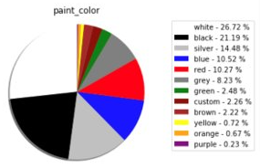
Data Preprocessing & Feature Engineering Pre-Modeling - Feature Creation
Feature Variables
Continuous: price : target variable MSRP odometer Time: year posting date Categorical: condition cylinders fuel title_status transmission drive type state New: car_age is_vintage is_color_neutral
Created Features:
Color: 12 colors into binary column of "is_neutral"
is_neutral (1): Black, White, Silver, Grey
Is_neutral (0): Colorful
car_age : year of posting_date subtracted by year when car came out
is_vintage: car_age >50
To account for vintage cars' higher price due to rarity and originality
Then, change data type into numeric format
Label Encoder applied to categorical variables
Notes:
Ask about depreciation column

Slide 18
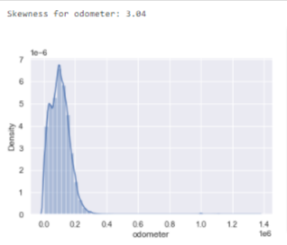
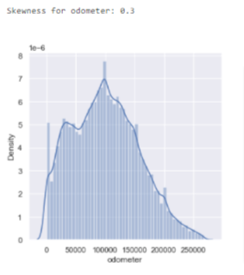
Data Preprocessing & Feature Engineering Post-Modeling - Re-engineering
Then after performing low on running models, we re-engineered some of our features
Contextual Anomaly Detection
1. Odometer:
Standard car odometer should have max 300,000 miles. Trimming data with 75th quantile + 3*IQR, ~268,000, as a cut reduced skewness from 3.04 to 0.3
Only new car should have 0 odometer so trimmed otherwise
2. Price:
Dropped cars below $1000 and greater than $200,000 that are in the extreme ranges not fit for our analysis purpose
Max car price was three billion dollars
3. MSRP:
MSRP is the manufacturer's suggested retail price (list price)
Dropped MSRP < car price as MSRP should be higher than used car selling price

Slide 19
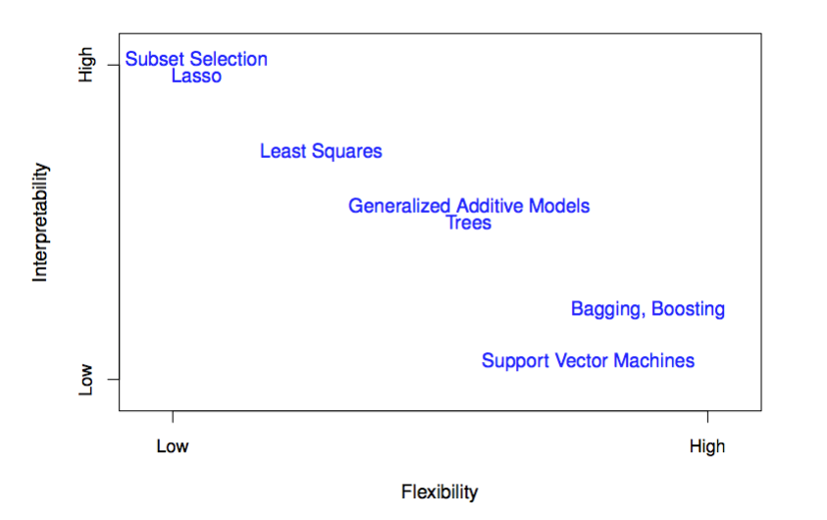
Modeling & Evaluation Models for Consideration
Our goal is to predict the sale price of a used car, which is a supervised regression problem. We pick our models base on two considerations, flexibility (accuracy) and interpretability.
We value model accuracy over interpretability because:
The industry we are in doesn’t require we provide explanation for the decision we make.
Features of our used car dataset are easy to understand, thus making it easy for us to debug the model even without high model interpretability.
Fig 1. Flexibility vs. interpretability tradeoffs for models
Models to consider are:
Linear Regression
Support Vector Regression with linear kernel
Decision Trees Ensemble method
Bagging Trees (Random Forest)
Boosting Trees

Slide 20
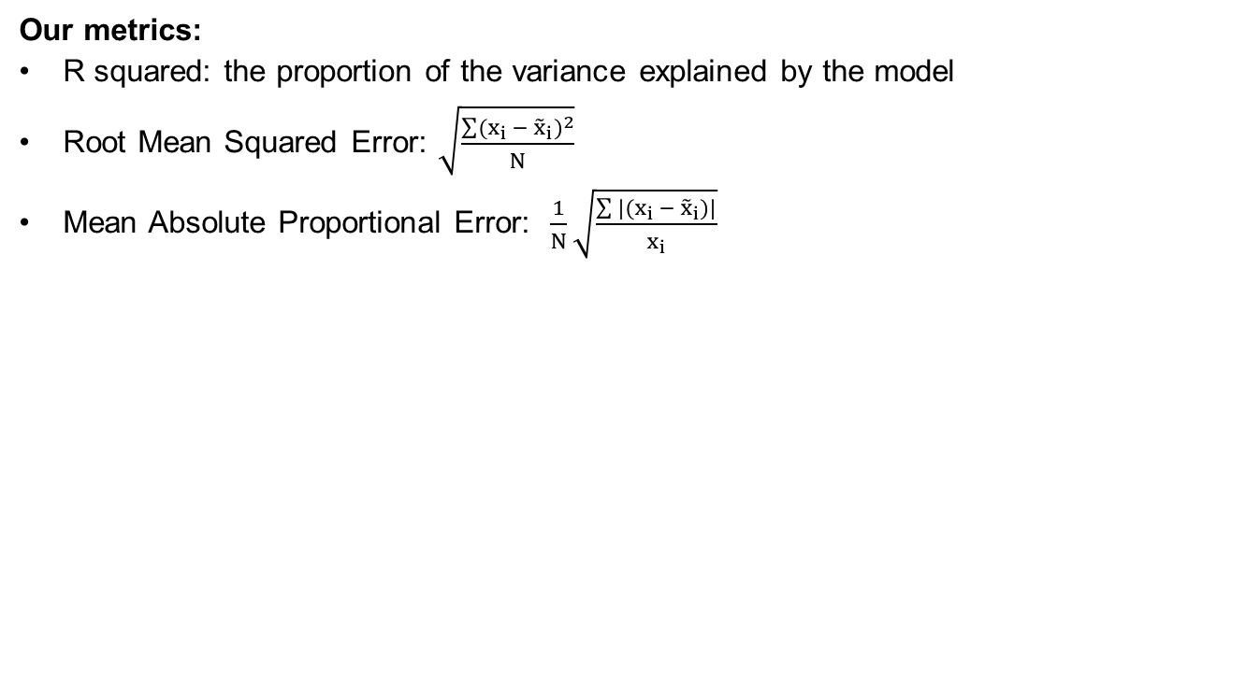
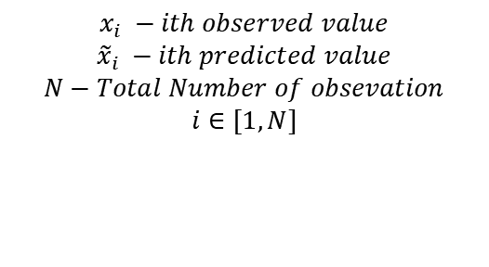
Modeling & Evaluation Our Approach
Our Guesses for Models:
Linear Regression is not flexible enough to capture all the variance of the model
SVR would be very slow to train. (SVR training time scale badly with large number of training sample)
Ensemble Trees would be the best method as it is flexible and has decent interpretability
Our Approach:
Train and tune all the models and compare the models’ accuracy
Select the model with the best metric scores
Our metrics:
R squared: the proportion of the variance explained by the model

Slide 21
Modeling & Evaluation Results
Results:
Just like our expectation, Ensemble Tree methods, specifically XGBoost has the best overall performance.
This is not very surprising since ensemble method is known to:
Have higher predictive accuracy, compared to the individual models.
Be very useful when there is both linear and non-linear type of data in the dataset
Linear Regression and Linear SVR, like expected, didn’t perform well. From the R squared score, we see that both models could not capture all the variance of our data.
XGBoost performs better than Random Forest.
Model | R Squared | Train RMSE | Validation/ Test RMSE | Test MAPE
Linear Regression | 0.68 | 5222.94 | 5272.66 | 0.49
Linear SVR | 0.65 | 5613.04 | 5626.03 | 0.43
Random Forest | 0.89 | 2971.65 | 3215.39 | 0.25
Gradient Boosting Machine | 0.89 | 3111.86 | 3179.89 | 0.25
XGBoost | 0.92 | 2400.81 | 2674.25 | 0.208

Slide 22
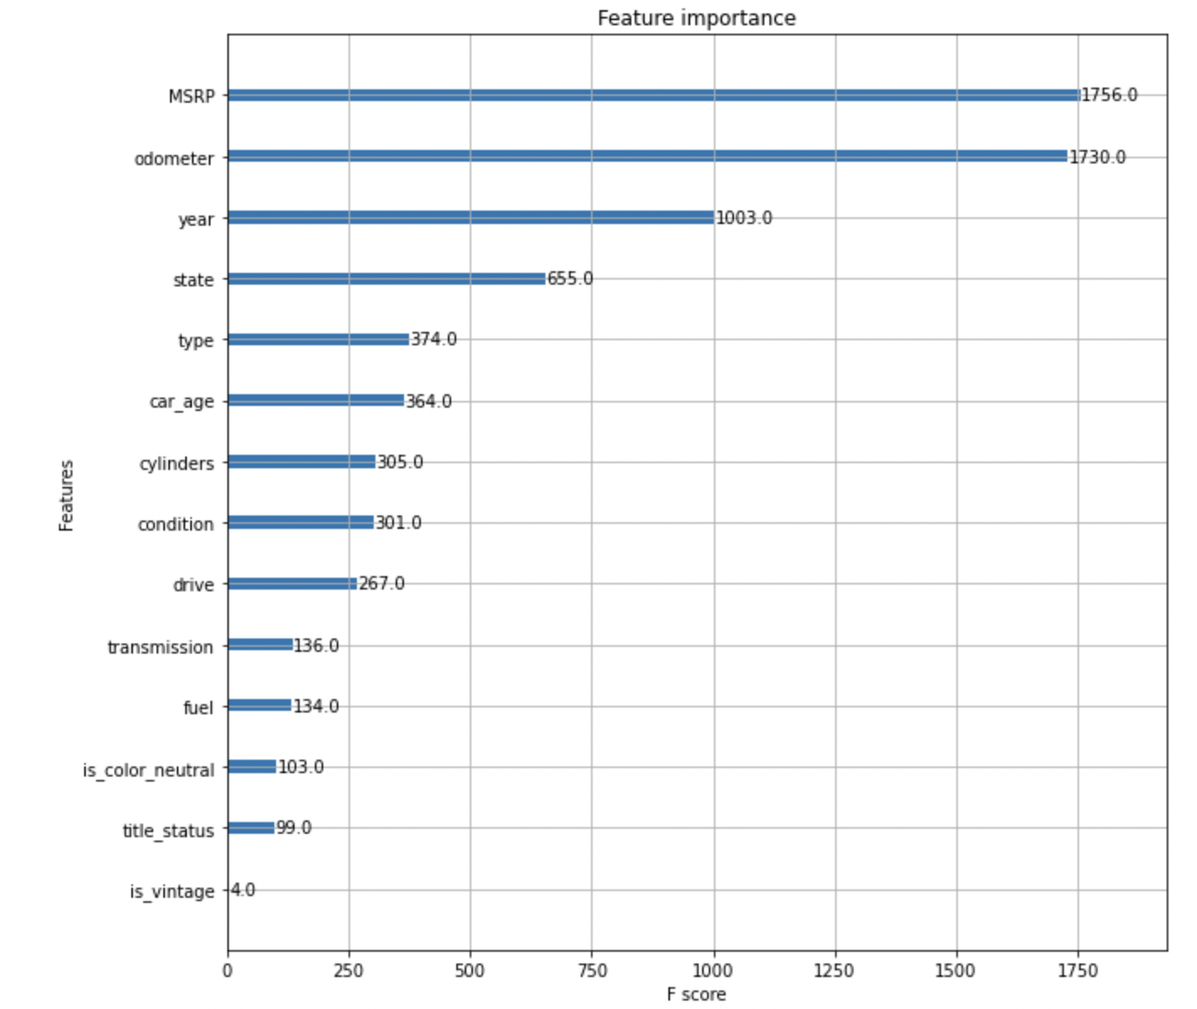
Feature Importance

Slide 23
Insights
Key Findings:
MSRP, odometer, and production year are proven to be top 3 strongest determinants of used car prices.
Expected from initial EDA as we observed correlations
States determine price range.
Higher price variance as years go by.
Some cars are not being sold as advertised (ex. Vintage cars may be lemons).
Challenges/Areas of Improvement:
Employ highly advanced NLP on textual data (description) excluding Ads, supplement the data with public reviews on each car, and apply topical modeling into our features.
Perform deeper research on car models with missing values and perform more thorough anomaly detection.
We could integrate image detection algorithms to see whether car is described as it is and additionally use them as features for modelling (CNN Image Classification)
Notes:
Findings after mining.
Interesting findings with descriptive analytics
A story integrating major findings into a plausible explanation
Proposed Future Extensions

Slide 24
Recommendations
Proposed Business Application To Problems of Information Asymmetry:
Craigslist should require sellers to fill in clearly defined forms for used cars so that 'information asymmetry' can be mitigated. (Now, it is not mandatory. 'Condition' criteria is also not clear, while this can be an important indicator.)
Craigslist or other platforms can present predictions (using the predictive model) of used cars so that buyers can get a sense of what is reasonable and have a base point for comparison.
Craigslist can also add exception criteria or specific section for vintage cars.
For reputation and quality assurance purposes, used car companies can use the predictions to target and filter out sellers prone to selling lemons prior to posting for sale.
Eventually, all these adjustments can be expected to improve the quality of used car listings in Craigslist, which in turn, can improve transaction success rate.
Notes:
Findings after mining.
Interesting findings with descriptive analytics
A story integrating major findings into a plausible explanation
Proposed Future Extensions

Slide 25
References
Data Sources:
Used Car Dataset: https://www.kaggle.com/austinreese/craigslist-carstrucks-data
MSRP Dataset: https://www.kaggle.com/CooperUnion/cardataset
iSeeCar: https://www.iseecars.com/
Tools:
Top2Vec: https://github.com/ddangelov/Top2Vec
OpenRefine: https://openrefine.org/
DiffLib: https://docs.python.org/3/library/difflib.html
Scrapy: https://scrapy.org/

Slide 26
THANK YOU

Slide 27
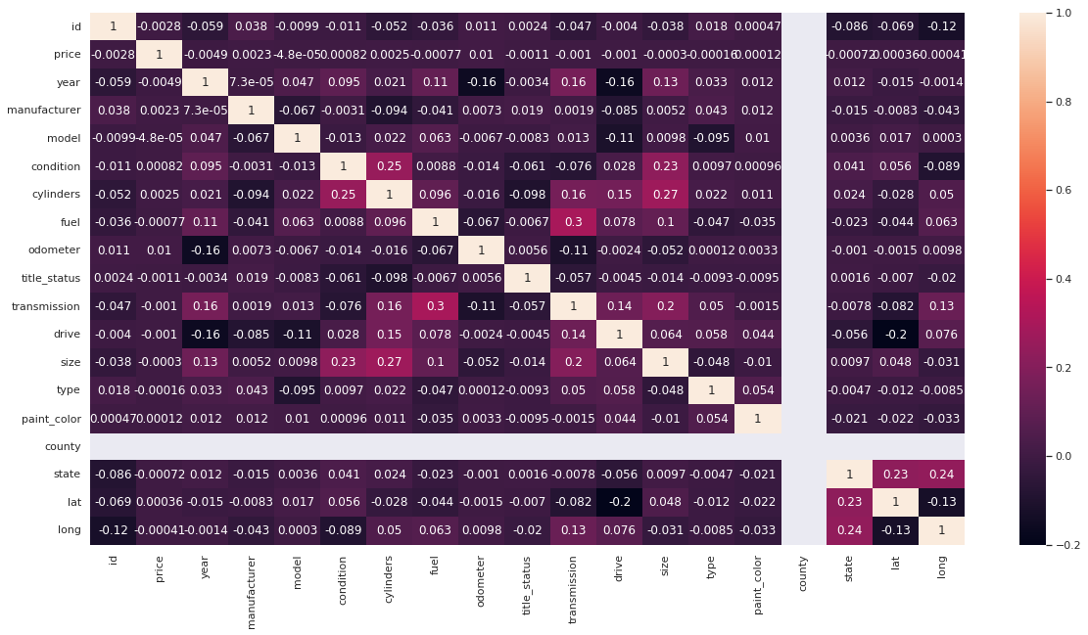
Appendix Correlation Table of the Raw Data

Slide 28
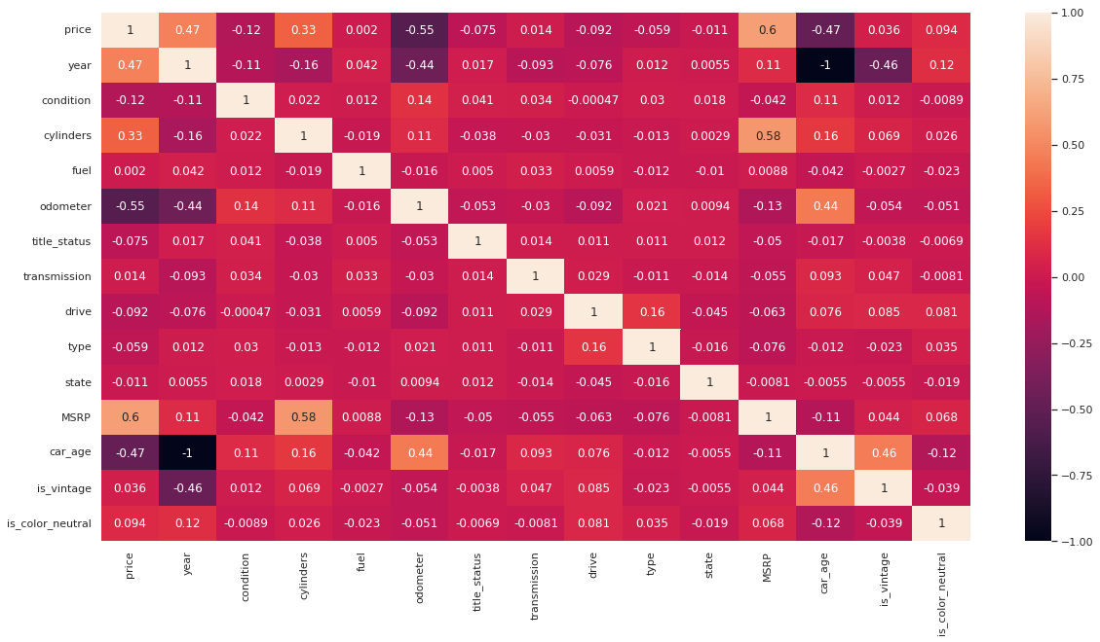
Appendix Correlation Table of the Clean Dataset

